Slide 1
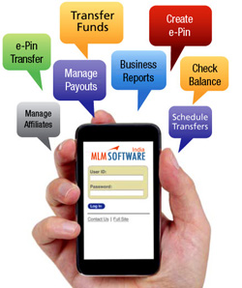
MOBILE BANKING

Slide 2
Mobile Banking (Financial)
Since 1925
Financial Mobile Banking services have been approved by RBI.
The APP is now available on the play store for android devices.
The customer can use mobile banking for the bellow services
Balance inquiry | Transfer funds (with in bank)
Schedule transfer | Transfer funds (other bank)
IMPS | Stop / Revoke Cheque
Mini Statement
www.adcbank.coop info@adcbank.coop

Slide 3
Customer can download the AP P from PLAY STORE.
Once the APP is installed the APP LOGO on any device
will look as shown in the image beside.
Firstly the APP will ask for the Registration.
Once when we click on the ADC Bank APP icon.
We will have Register one time to use the Application.

Slide 4
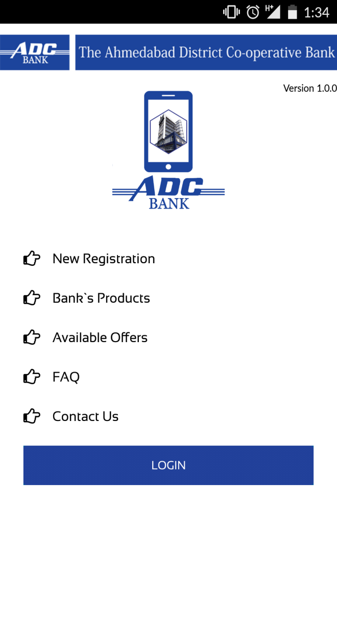
First screen - Mobile APP
Once the INSTALLATION is successful the screen will appear as shown in the same slide.
Following MENU appears on the APP screen:
1) New Registration
2) Bank’s Products
3) Available Offers
4) FAQ
5) Contact Us

Slide 5
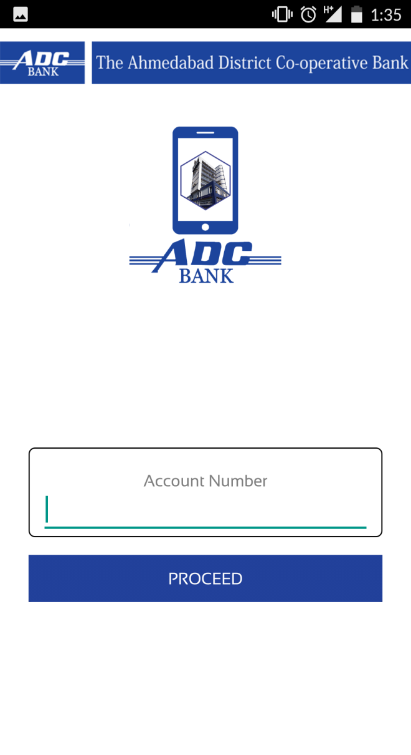
NEW REGISTRATION Screen
On clicking New Registration Application will ask to Enter Account Number.
Enter Your Account Number and click PROCEED

Slide 6
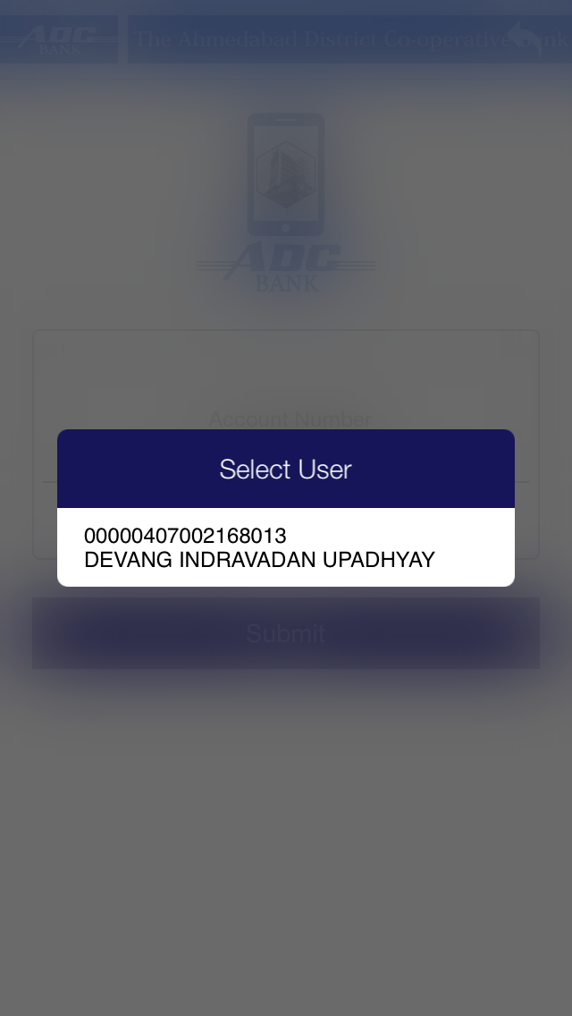
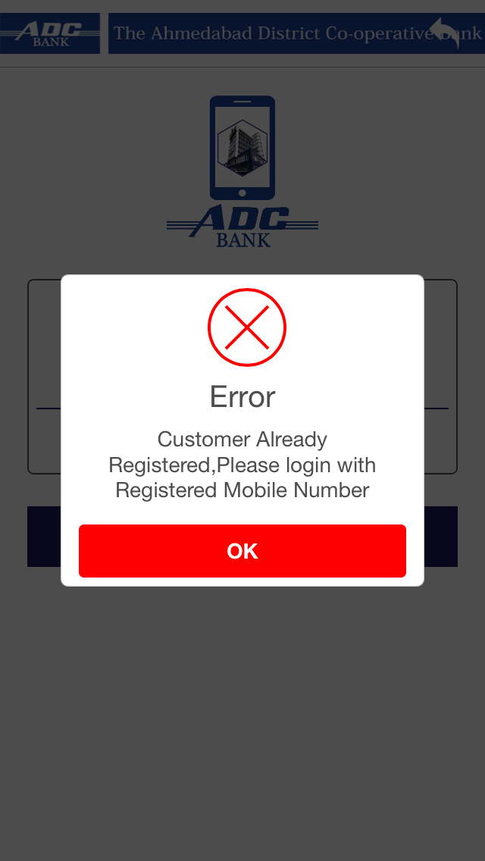
NEW REGISTRATION Screen
The next screen will show User Name and CIF Number, user needs to select it and process further.
If user is already registered application will show error.

Slide 7
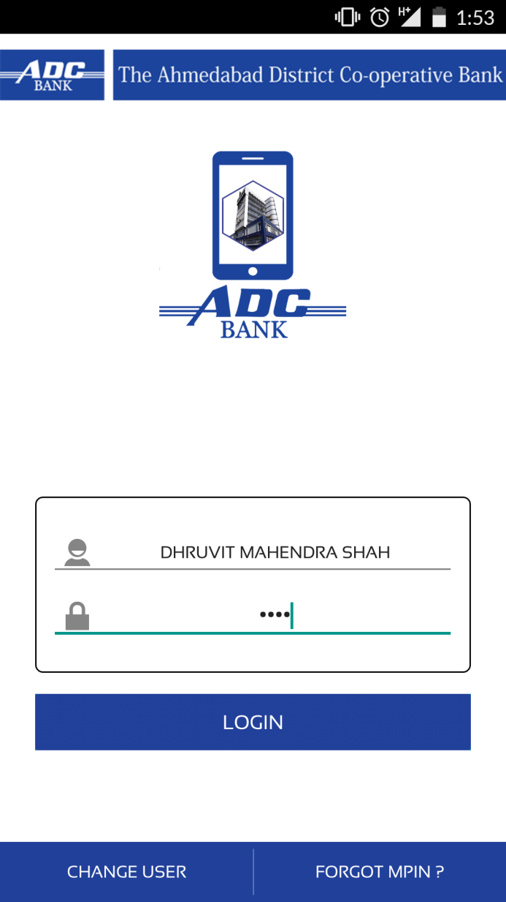
LOGIN Screen
After Successful completion of registration Login Screen will appear.
USER NAME will display automatically
Enter 4-digit Pin Number and click LOGIN

Slide 8
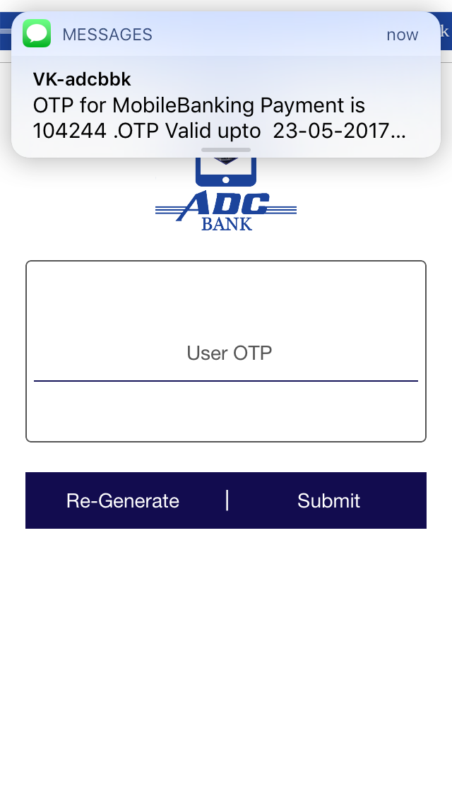
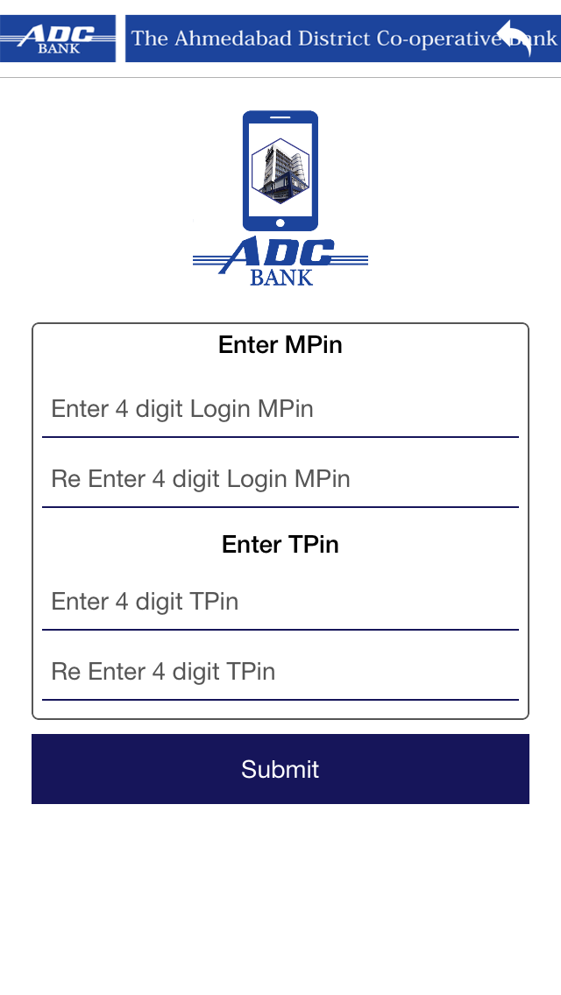
Forgot M-pin
When user click on Forgot Mpin a OTP will sent to user’s registered mobile number
After entering OTP user can change Mpin and Tpin.

Slide 9
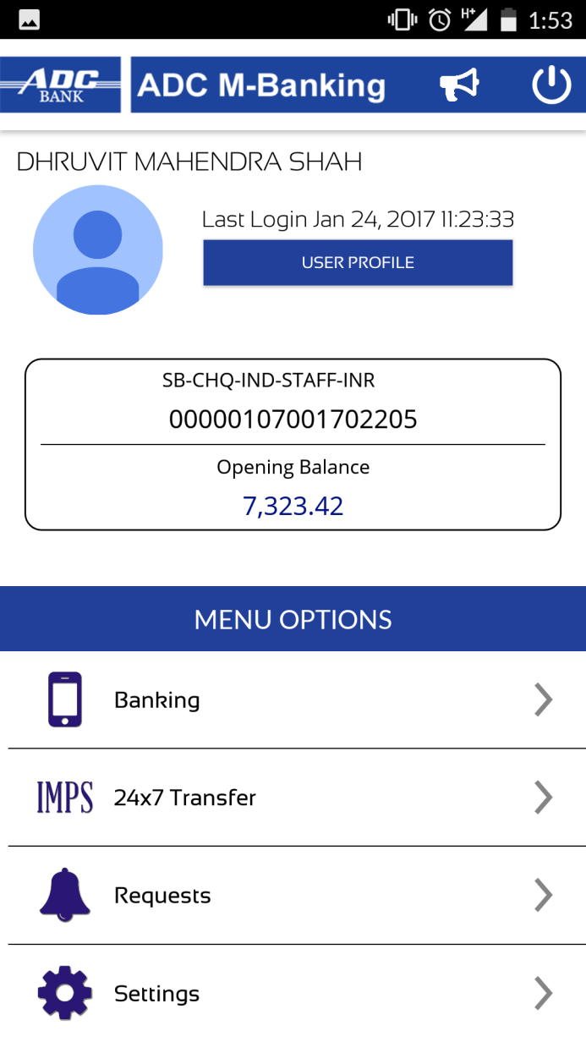
Home screen - Mobile APP
After Login User Home screen will appear.
Following details are mentioned in the Home screen:
User Name
Last Login date & time
User Profile
Profile Picture
A/C Type, A/C Number & Balance
Menu Options
Banking
IMPS
Requests
Settings
Notification
Logout

Slide 10
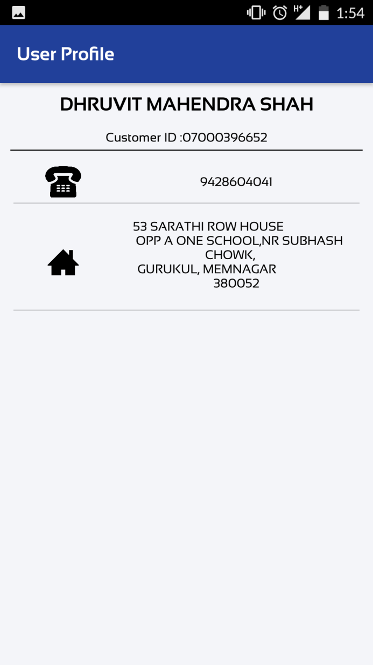
USER PROFILE - Mobile APP
On Clicking USER PROFILE Following details will be display on the screen
Customer Name
CIF Number
Registered Mobile Number
Address

Slide 11
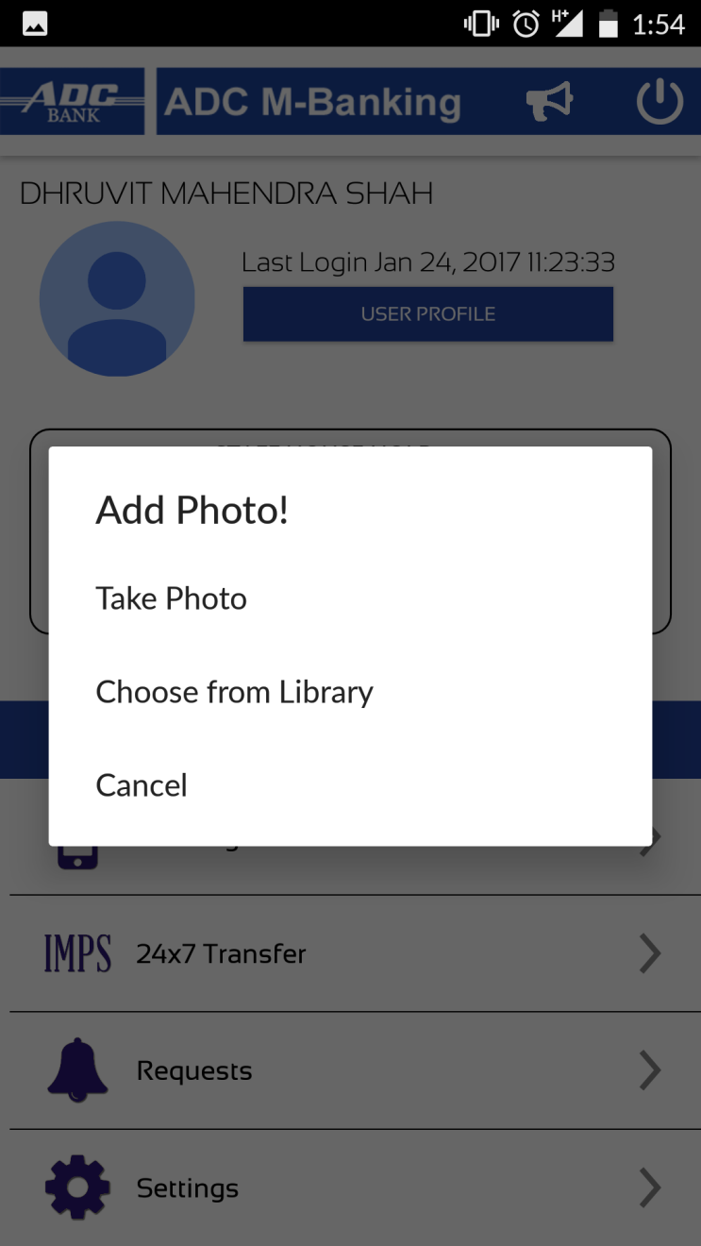
PROFILE PICTURE - Mobile APP
Now User can add His / Her Profile picture in NEW Application
User needs to click on Picture Icon on the Home Screen, application will ask to Add Picture.
User can Take Picture or Choose picture from the Gallery.

Slide 12
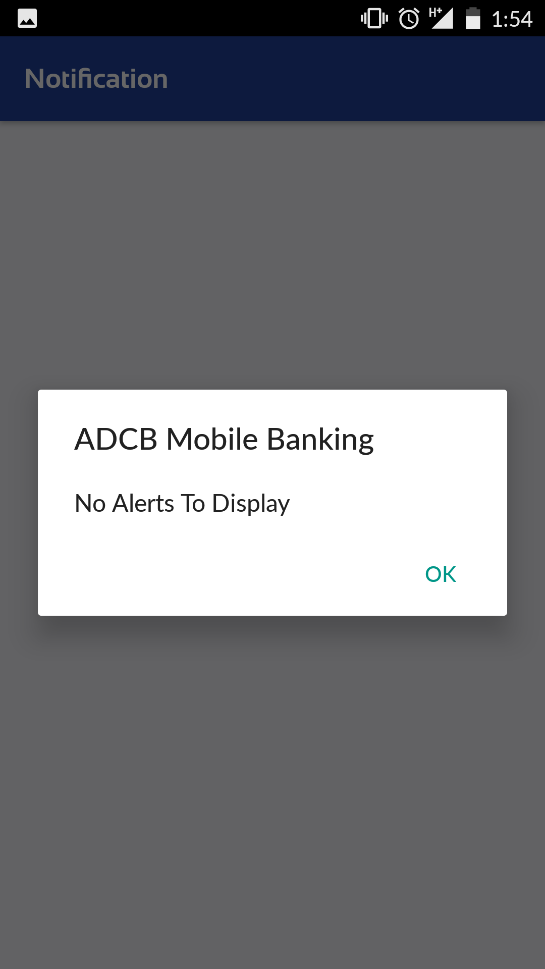
NOTIFICATION SCREEN - Mobile APP
NOTIFICATION Screen displays latest Alert and Notification on User’s Mobile Application Screen.

Slide 13
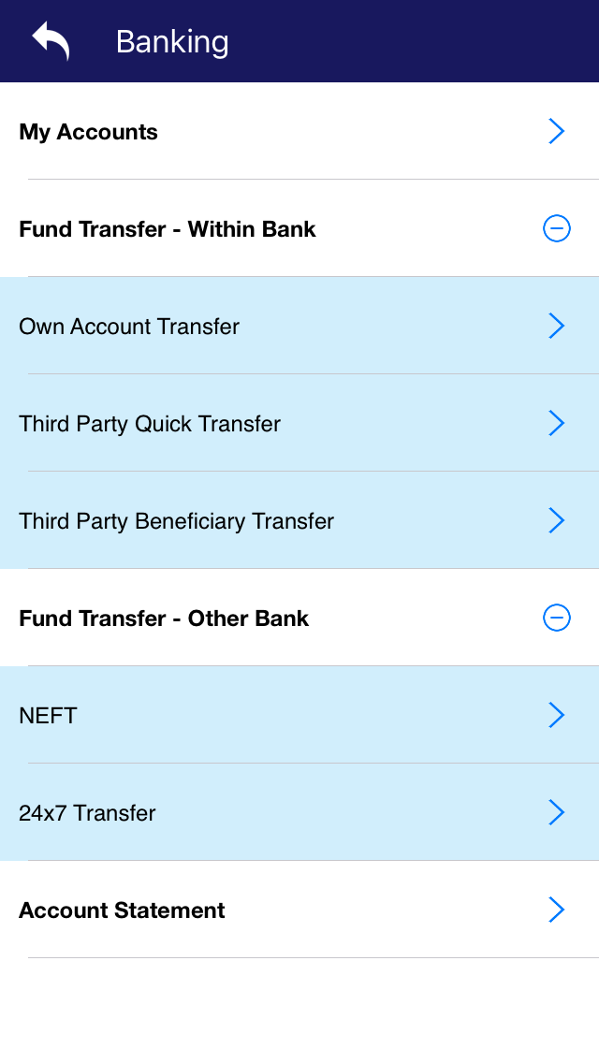
MENU - BANKING
In the Banking Option following options are available
My Account
Fund Transfer Within Bank
Fund Transfer Other Bank
Account Statement

Slide 14
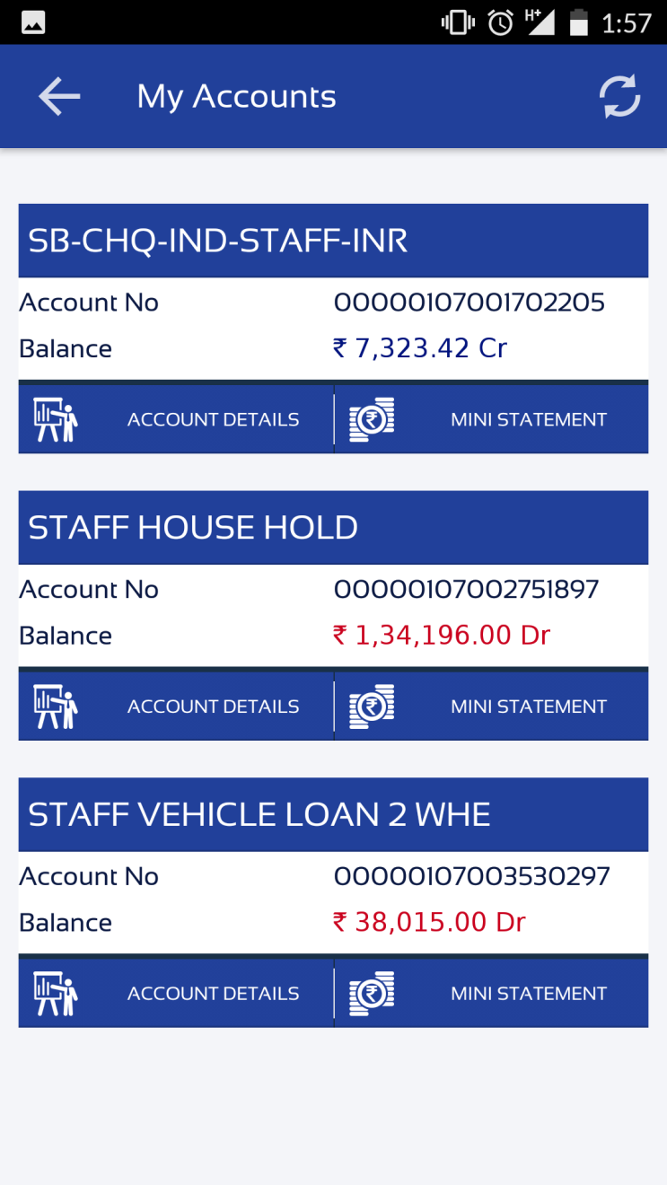
MY ACCOUNT - BANKING
In the My Account Option Customer can check all the accounts present in one CIF.
User can check following details from My Account
All Account Number present in CIF and Balance of that account
Mini Statement
Account Details

Slide 15
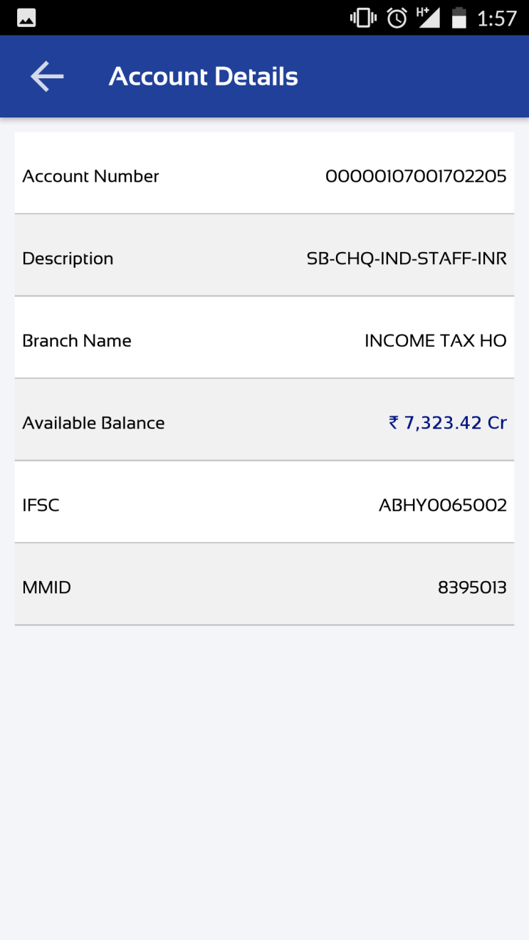
ACCOUNT DETAILS - BANKING
Account Details will display account information like
A/C Number
Type of Account
Branch name
Available Balance
IFSC Code
MMID

Slide 16
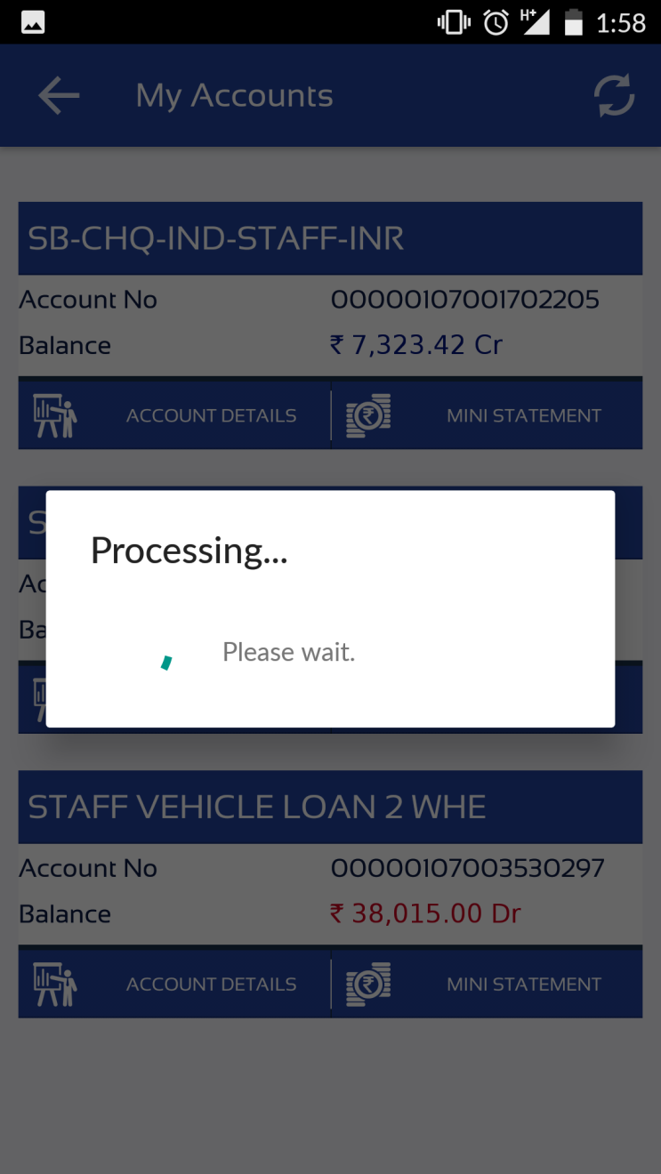
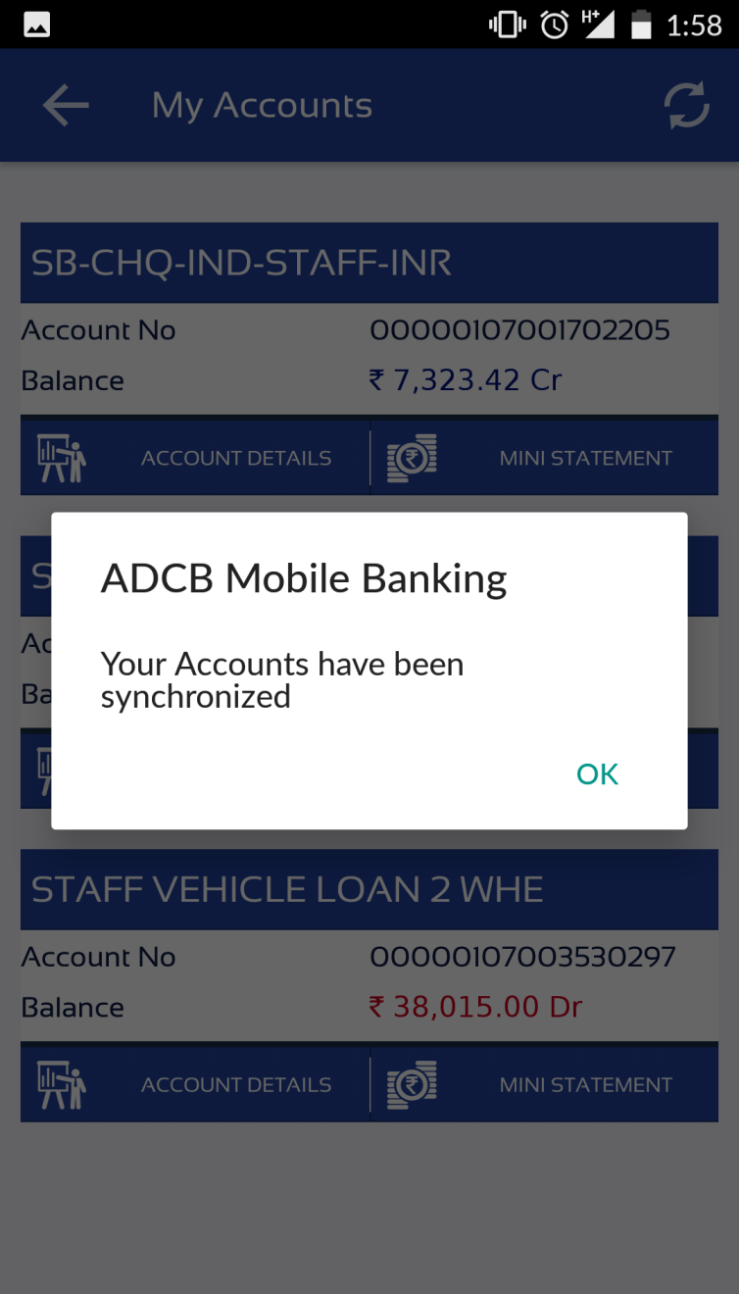
SYNCHRONIZATION - BANKING
Synchronization will synchronize Account information with Mobile Application

Slide 17
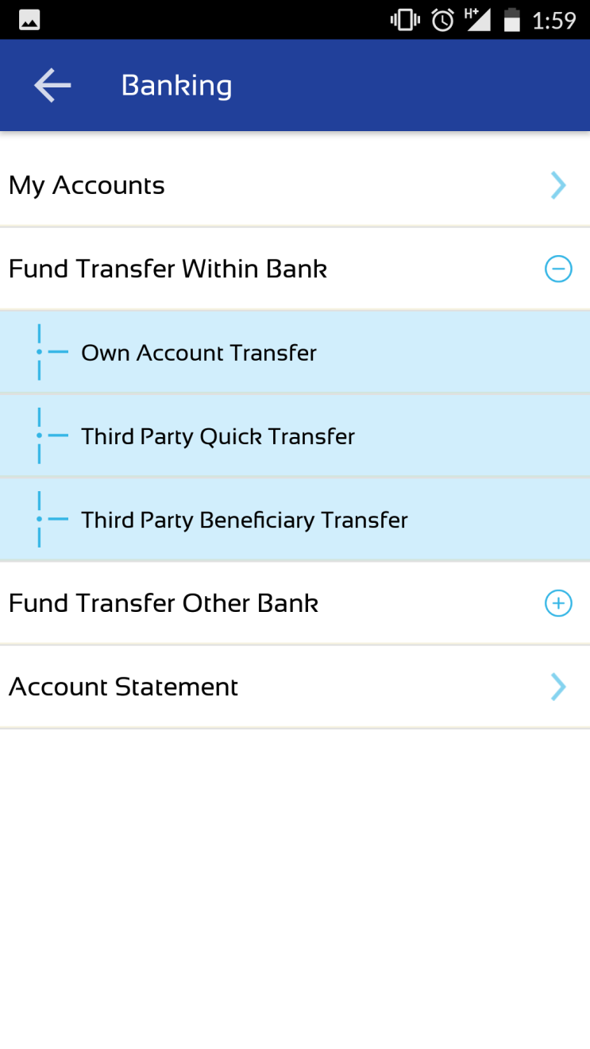
FUND TRANSFER WITHIN BANK - BANKING
Fund Transfer within bank will display information as below
Own Account Transfer (Self Account ADC to ADC)
Third Party Quick Transfer (ADC to ADC Quick Transfer)
Third Party Beneficiary Transfer (ADC to ADC beneficiary Transfer)

Slide 18
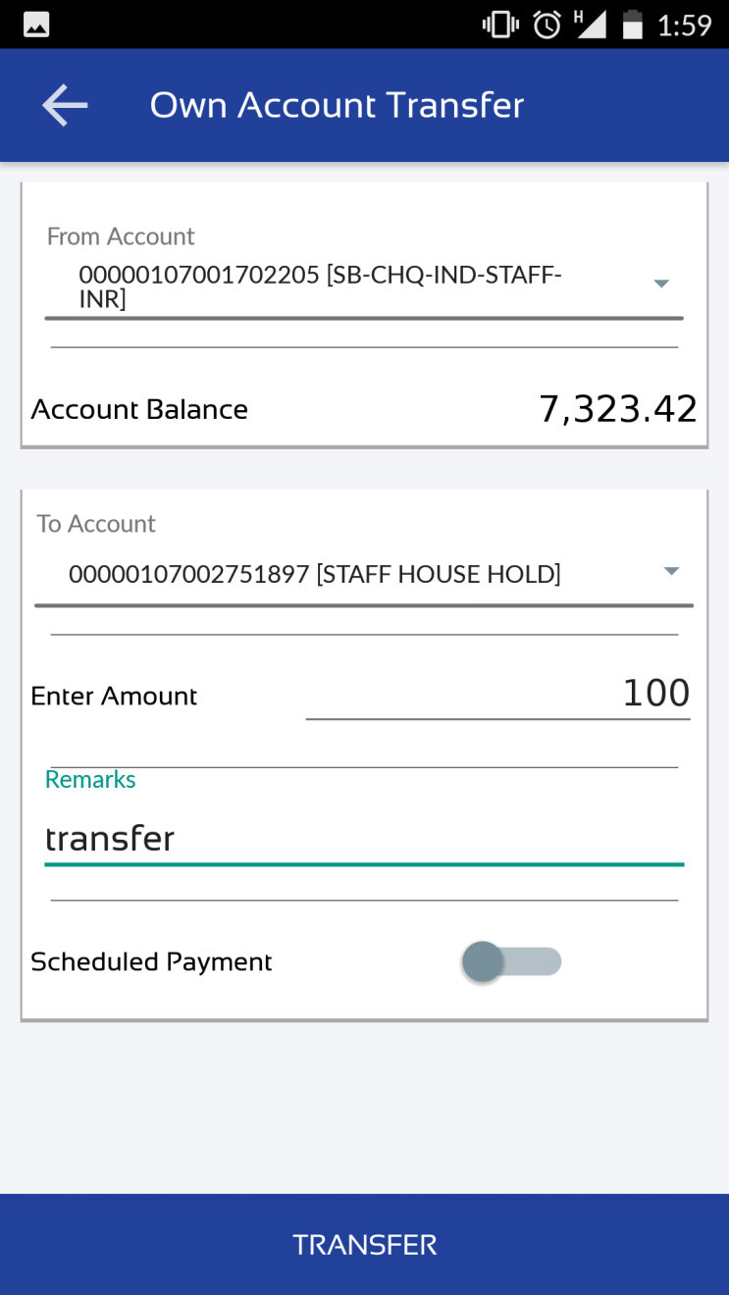
OWN ACCOUNT TRANSFER - BANKING
With Own Account Transfer link user will transfer Fund from his / her ADC account to other ADC account
Customer have to select From account and To account to transfer fund, than Enter the amount to transfer and click on TRANSFER Link

Slide 19
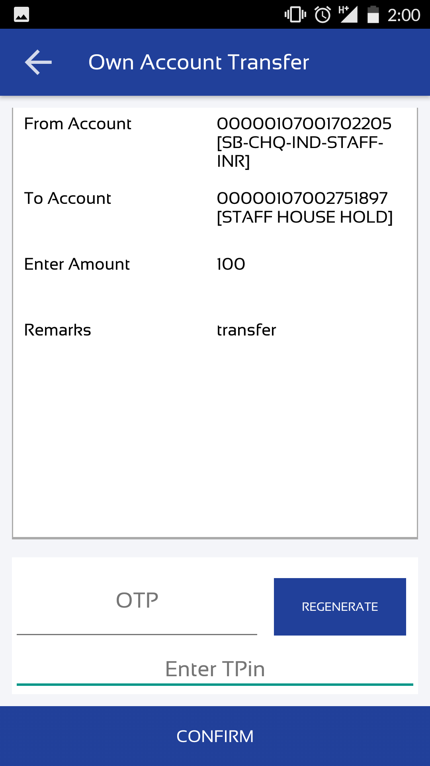
OWN ACCOUNT TRANSFER - BANKING
Confirmation Screen will display the details entered by user.
User required to enter OTP and TPIN to transfer the fund to other account.

Slide 20
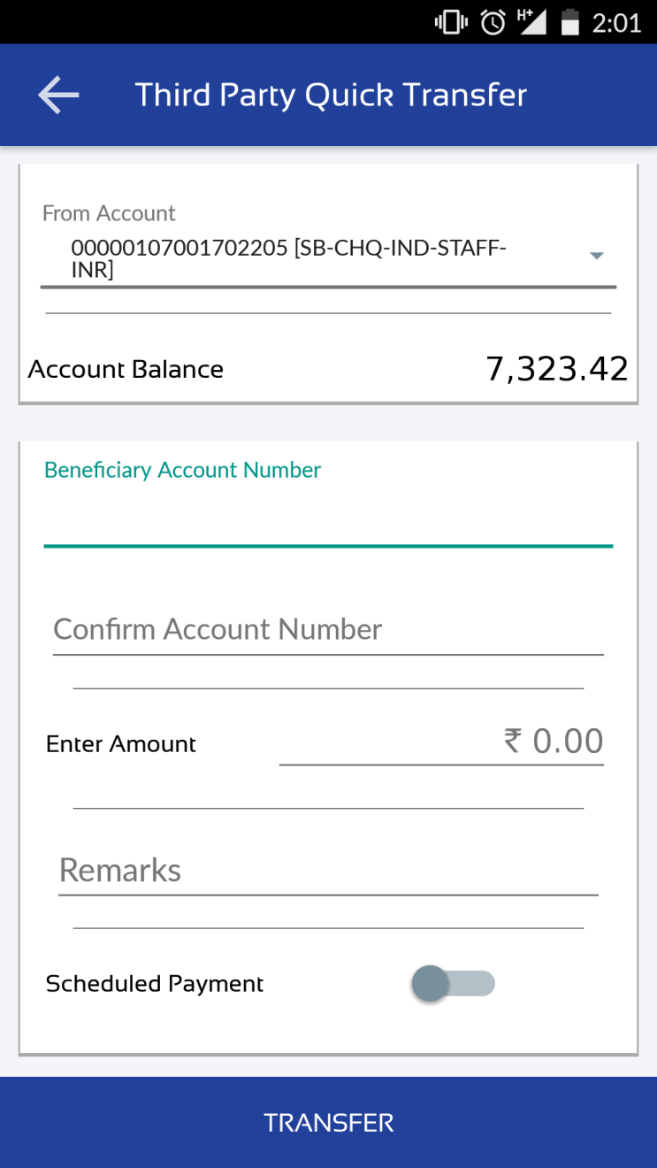
THIRD PARTY QUICK TRANSFER - BANKING
In third party quick transfer user does not need to add Beneficiary.
User needs to enter the beneficiary account number as shown in screen for third party quick transfer.

Slide 21
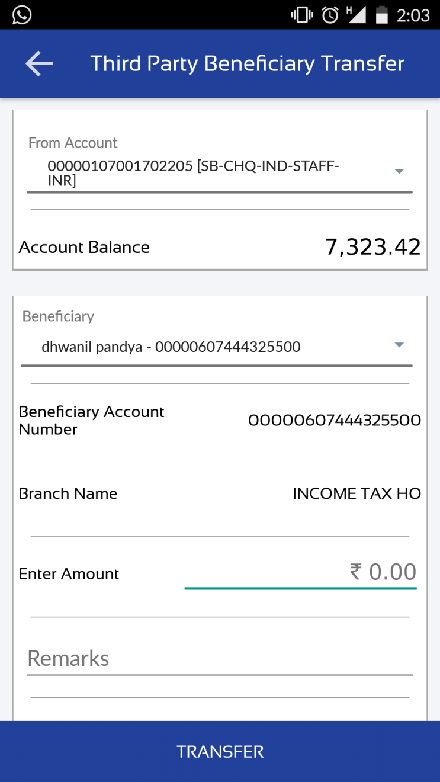
THIRD PARTY BENEFICIARY TRANSFER - BANKING
In third party beneficiary transfer user needs to add Beneficiary first.
Beneficiary can be added from the Manage Beneficiary in Setting screen.
User can Schedule fund transfer at any date if Required, for that user need to enable schedule payment and Select date from the calendar.

Slide 22
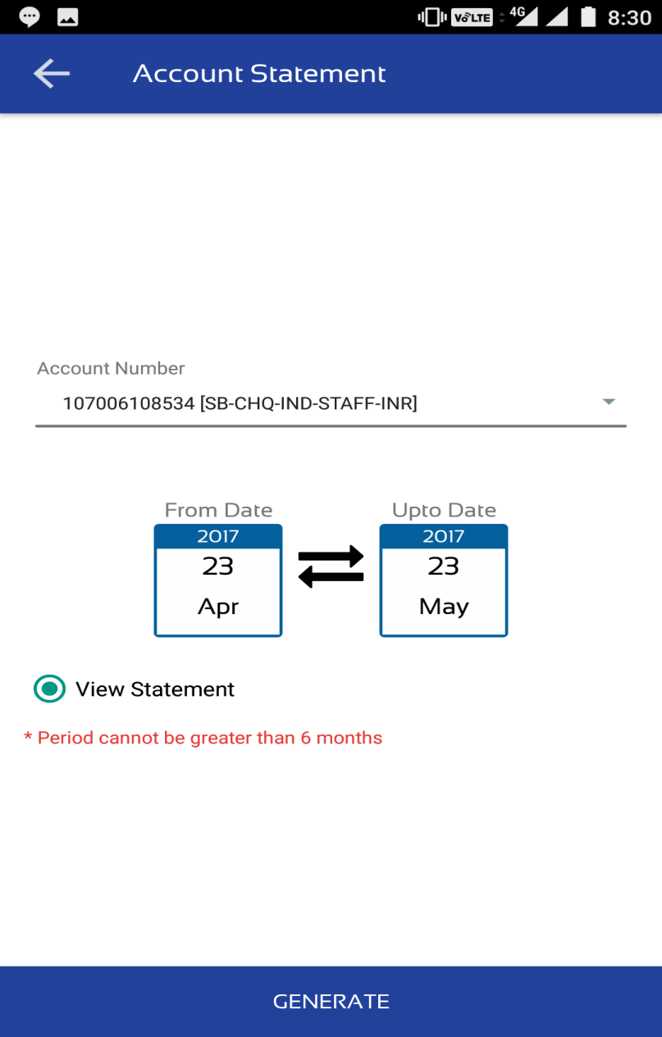
ACCOUNT STATEMENT - BANKING
Account Statement Will Display transaction made from that Account.

Slide 23
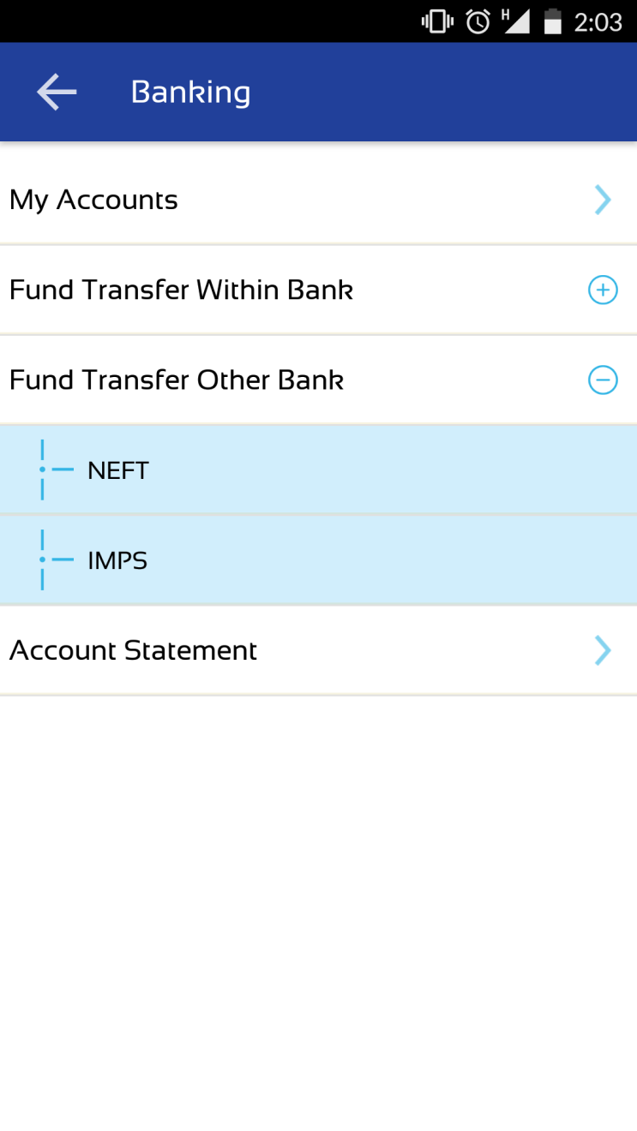
FUND TRANSFER OTHER BANK - BANKING
Fund Transfer other bank will display two options as below
NEFT
IMPS
To Transfer Funds using NEFT or IMPS first user needs to add Beneficiary.

Slide 24
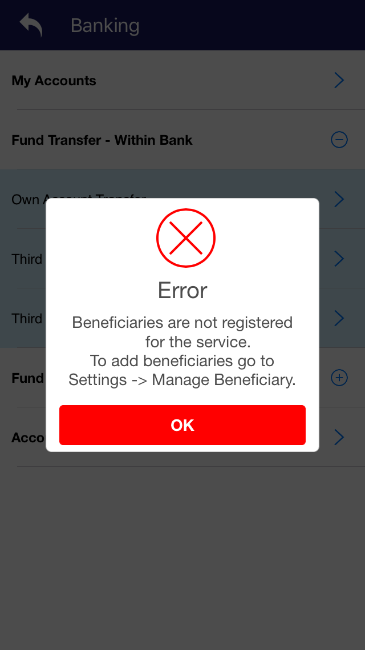
Beneficiary Registration Error - BANKING
IF no beneficiary has been registered application will show error message.

Slide 25
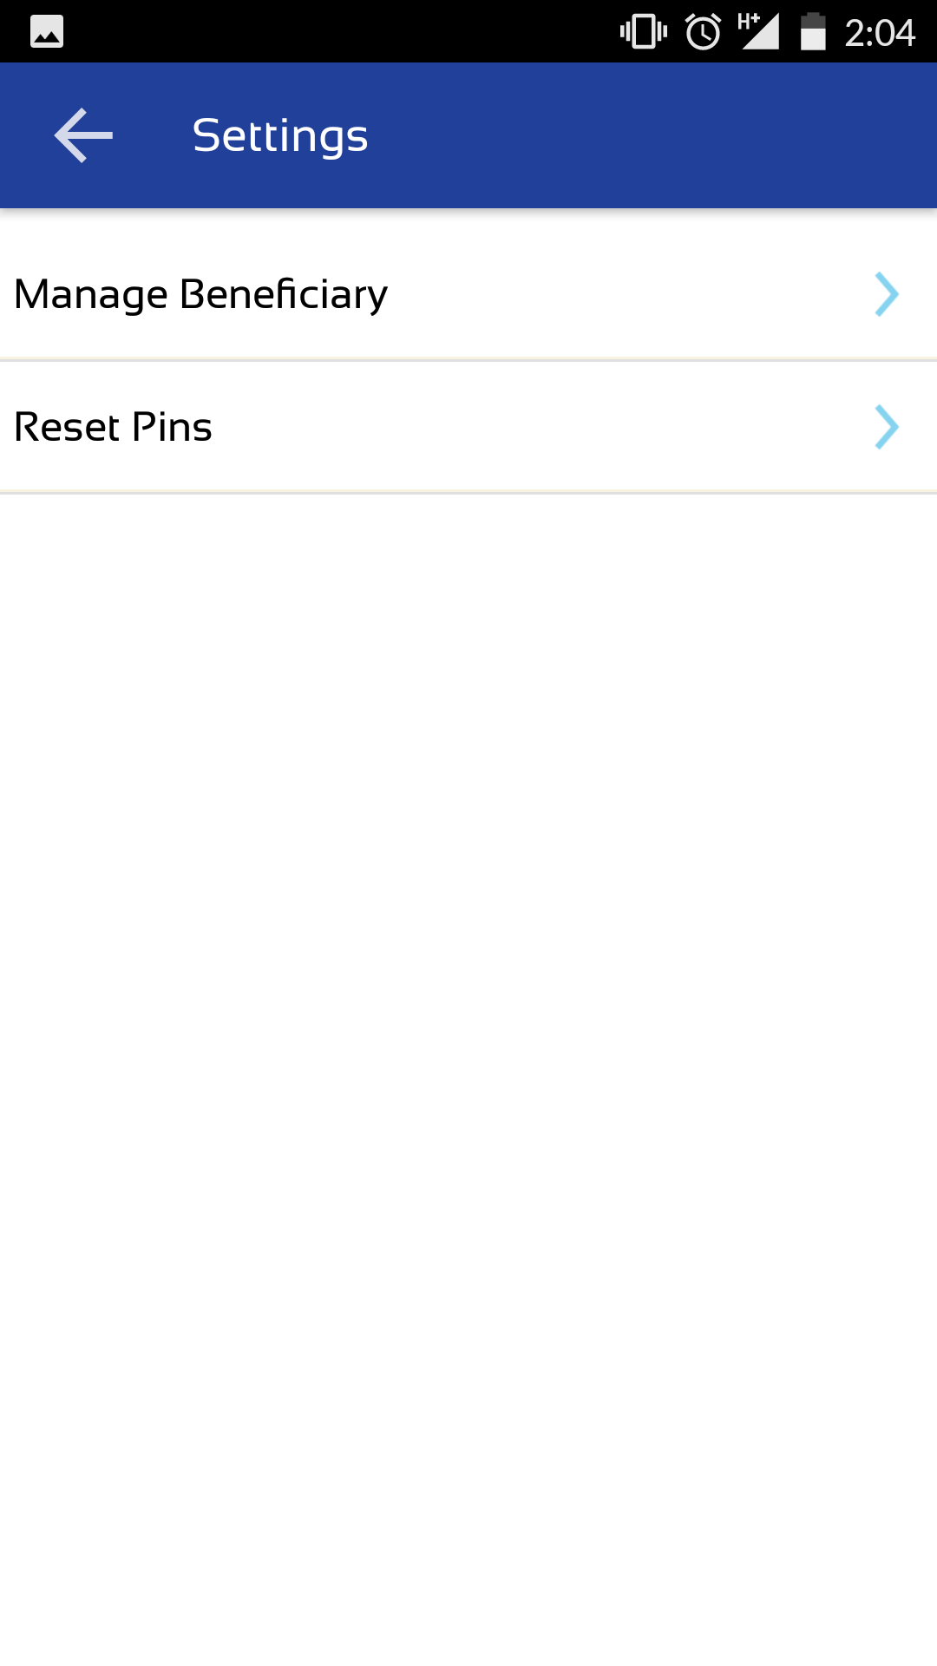
SETTING SCREEN
Setting screen has two options as below
Manage Beneficiary
Reset Pins

Slide 26
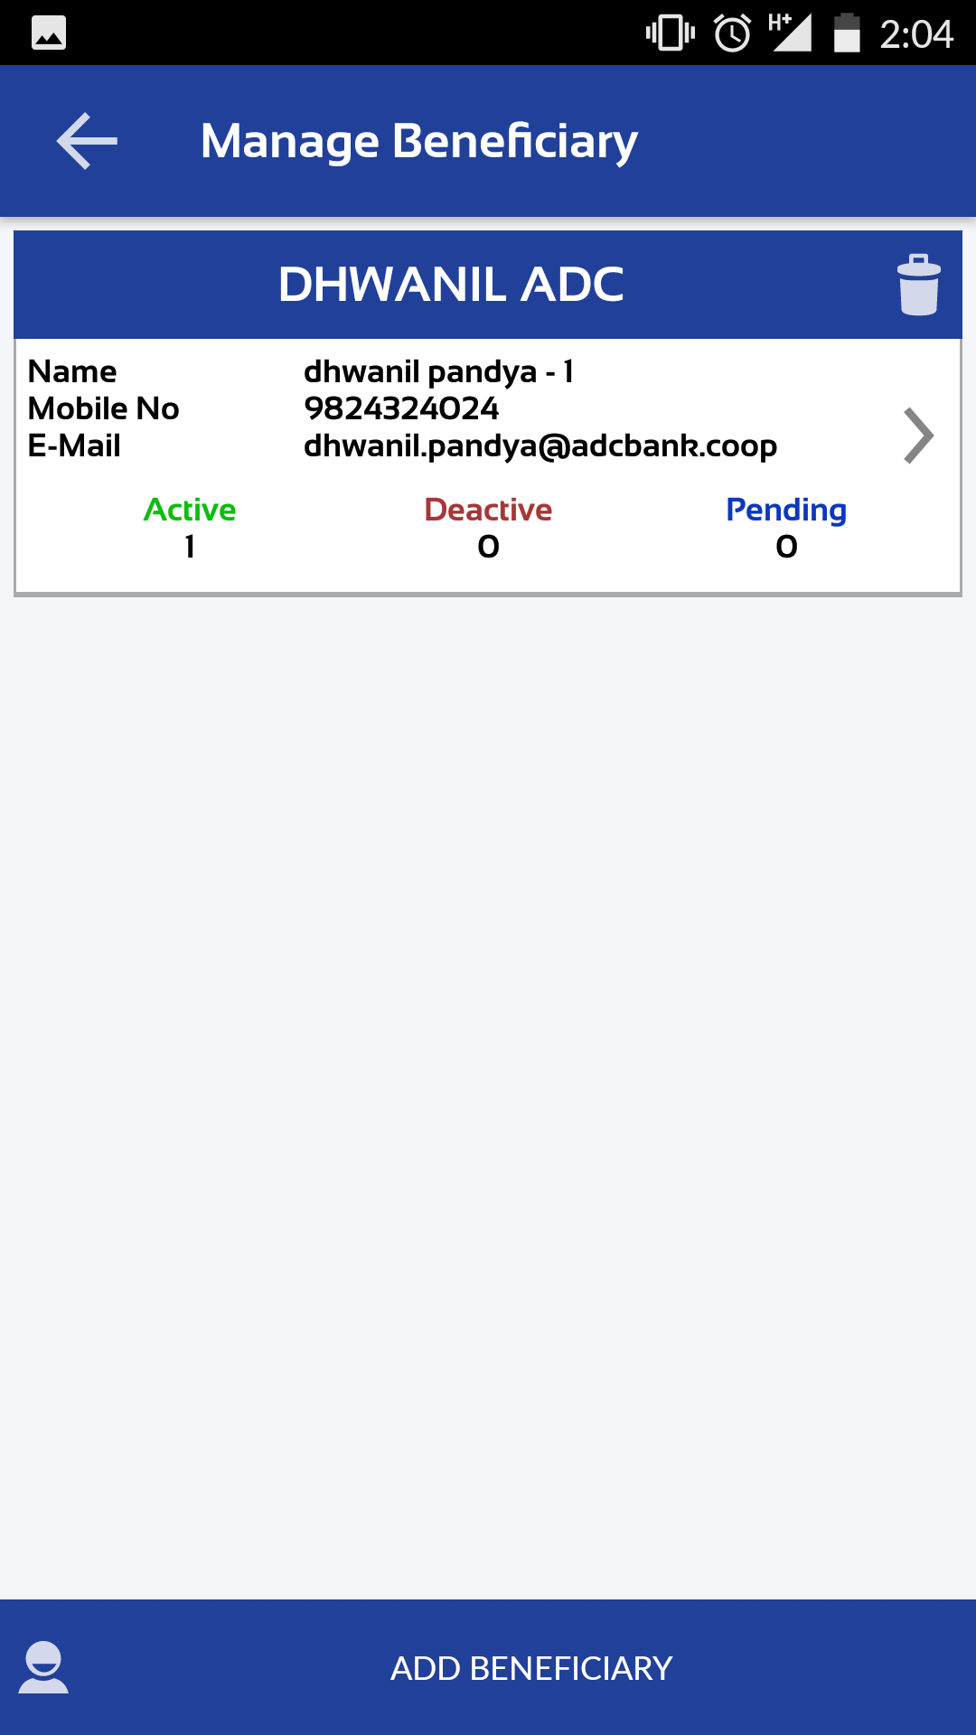
MANAGE BENEFICIARY - SETTING
Manage Beneficiary will display all added beneficiary information.
To ADD beneficiary click on ADD BENEFICIARY.

Slide 27
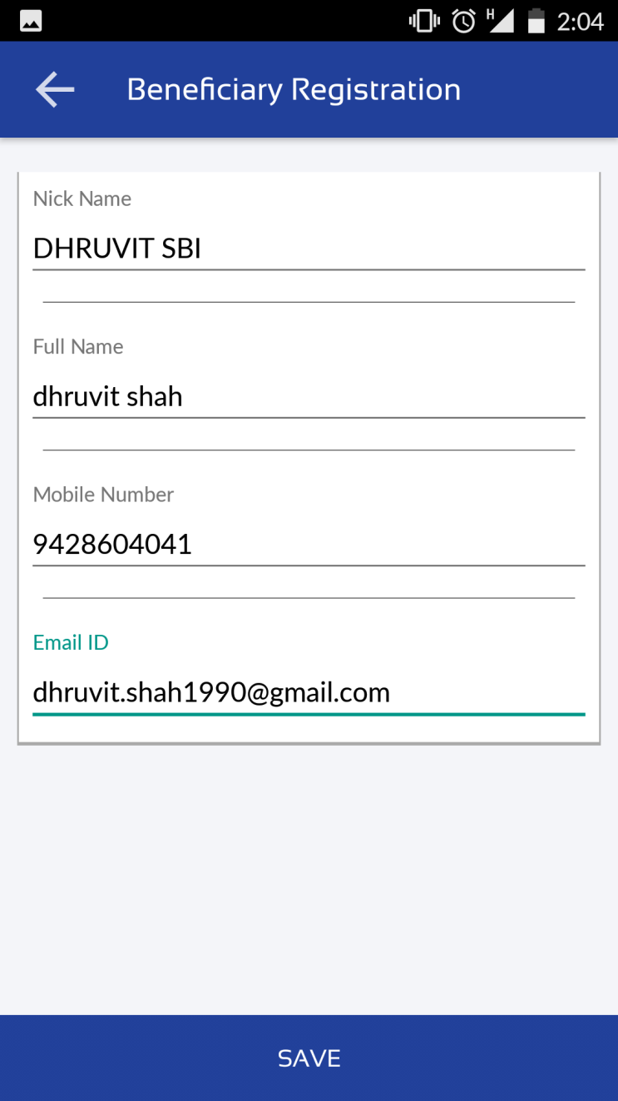
ADD BENEFICIARY - SETTING
To add beneficiary user needs to enter details as displayed in screen
Nick Name (To display name while transfer funds)
Full Name
Mobile Number
E-mail ID

Slide 28
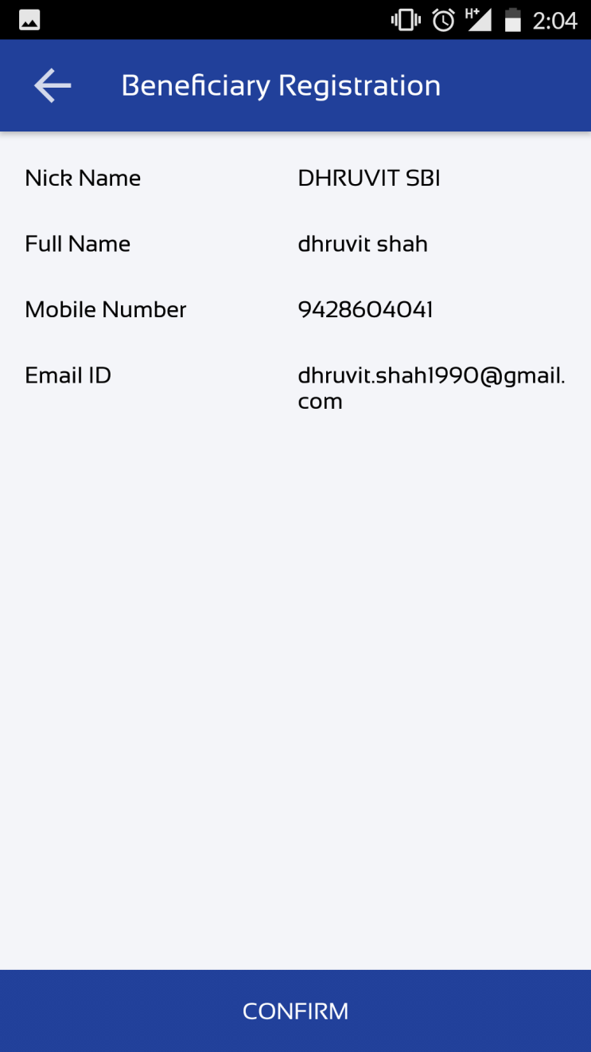
CONFIRM BENEFICIARY - SETTING
After saving the details application will display user’s entered details for confirmation.

Slide 29
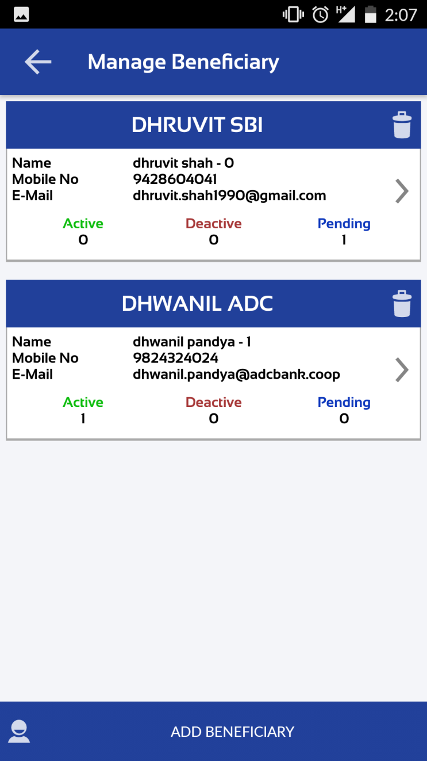
MANAGE BENEFICIARY - SETTING
After confirmation beneficiary will displayed on the screen.
To transfer funds first user needs to Active beneficiary, For that click on beneficiary who is showing pending.

Slide 30
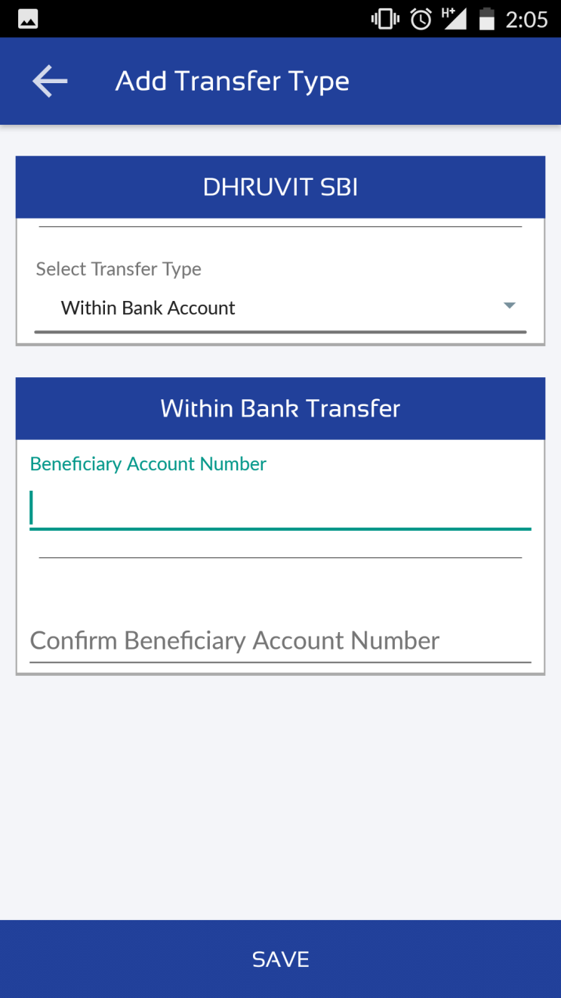
ADD TRANSFER TYPE - SETTING
After activation of Beneficiary user needs to select transfer type for that beneficiary to transfer funds.
Transfer types are as below
Within Bank Account
Account Number
Confirm Account Number
Other Bank Account
Account Number
Account Type
IFSC Code
IMPS
Mobile Number
MMID

Slide 31
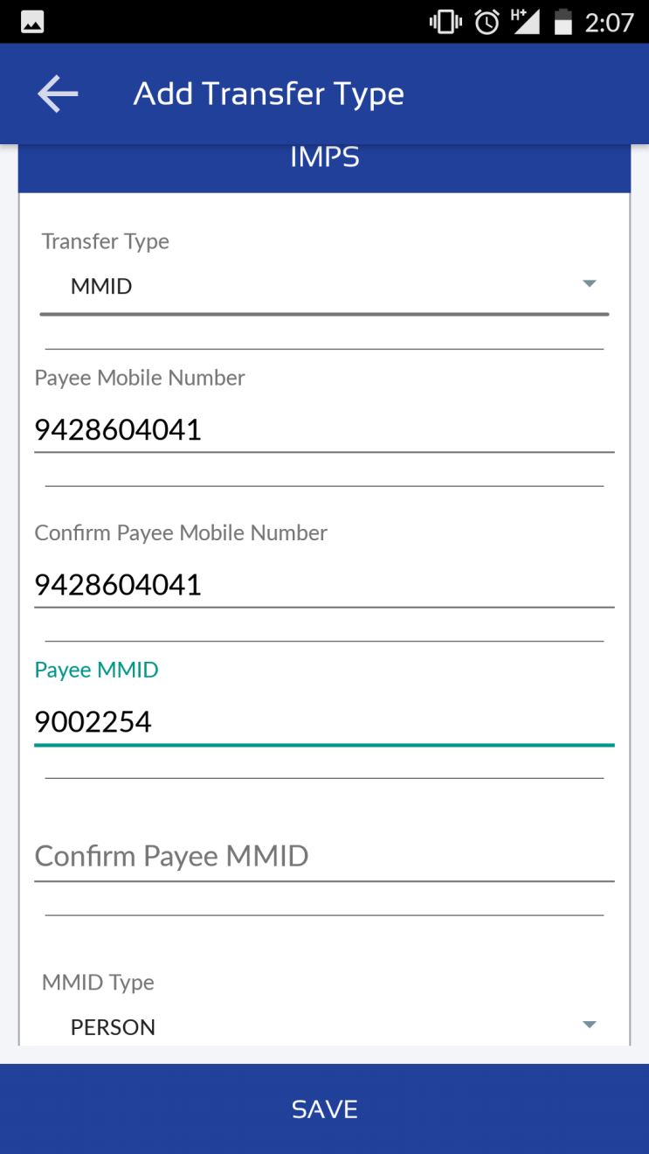
ADD TRANSFER TYPE - SETTING
Enter the details as shown in figure after selecting the transfer type.

Slide 32
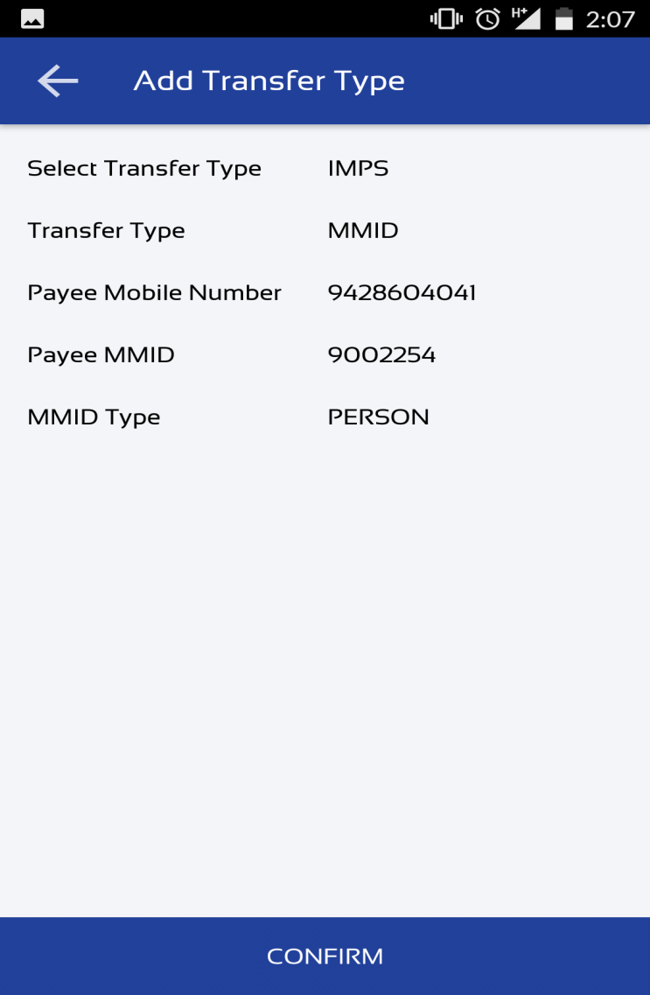
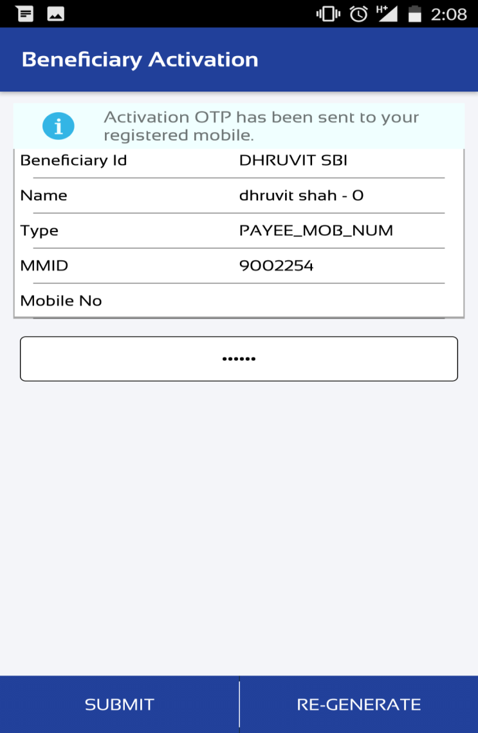
CONFIRM TRANSFER TYPE - SETTING
Application will show the details entered by user to confirm transfer type.
Enter OTP and click SUBMIT.

Slide 33
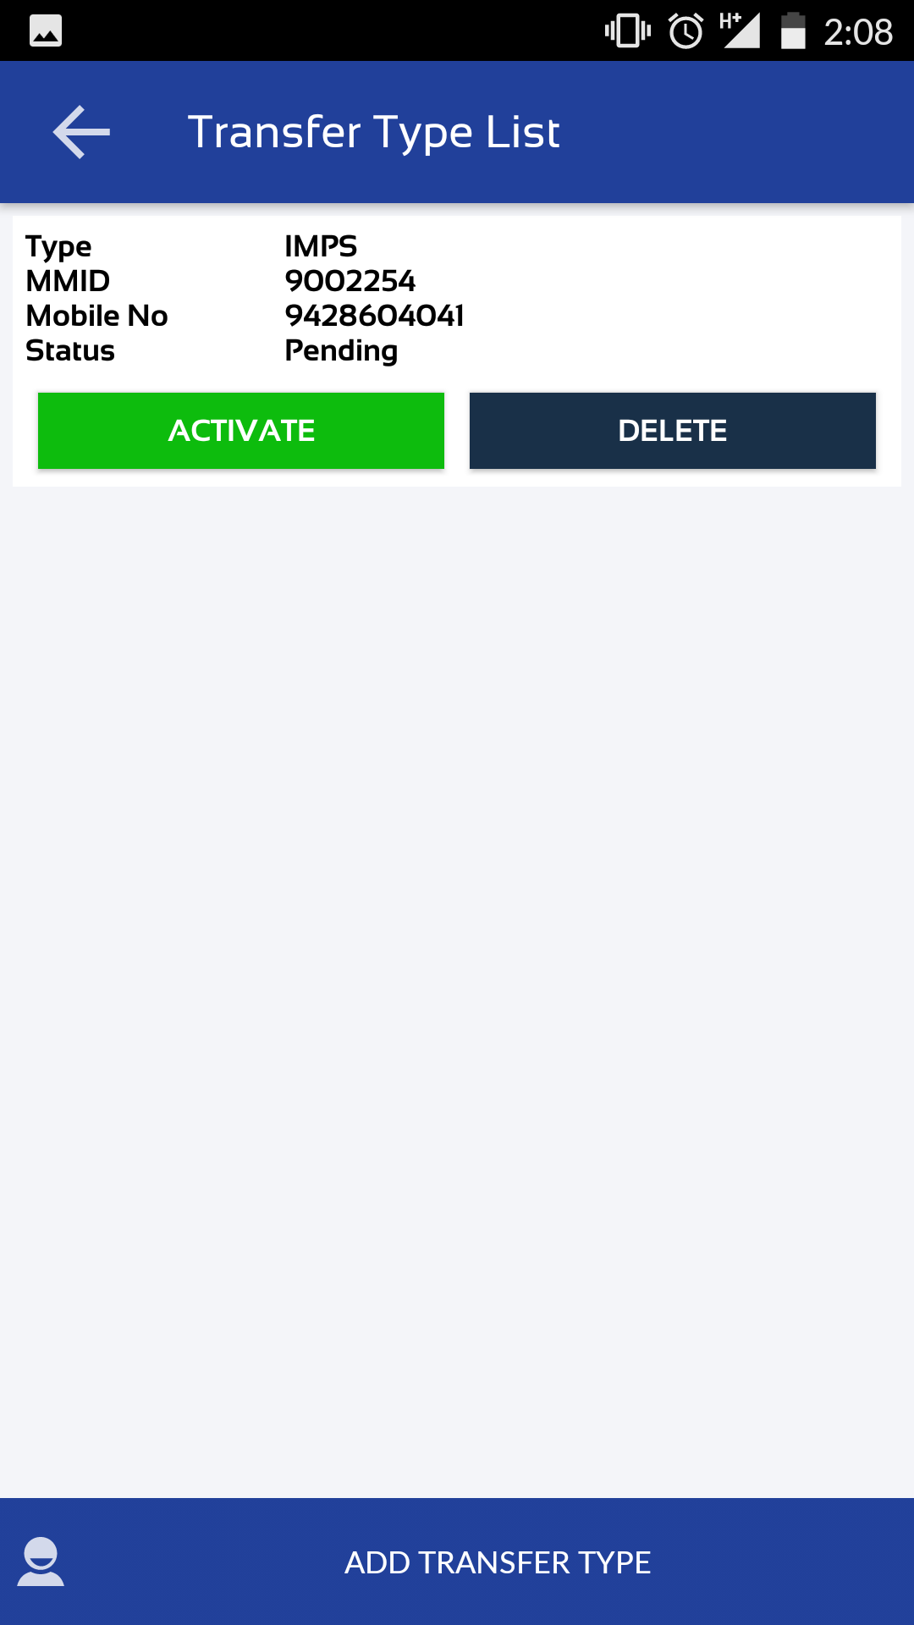
ACTIVATE BENEFICIARY - SETTING
Click on ACTIVATE for beneficiary activation

Slide 34
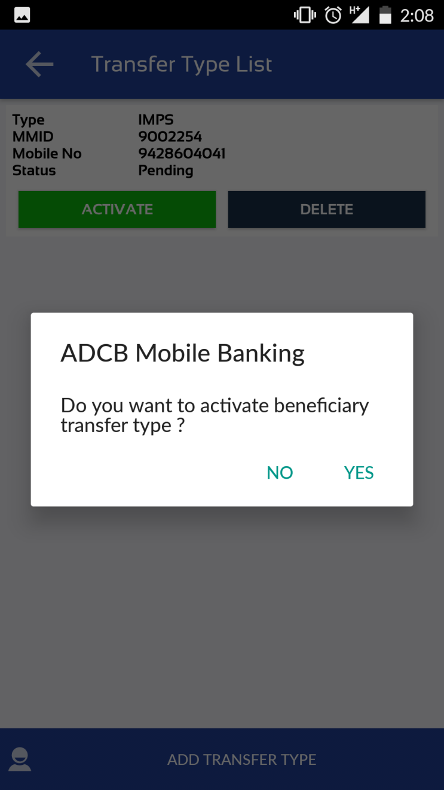
CONFIRM ACTIVATE BENEFICIARY - SETTING
Application will ask to confirmation activation of beneficiary

Slide 35
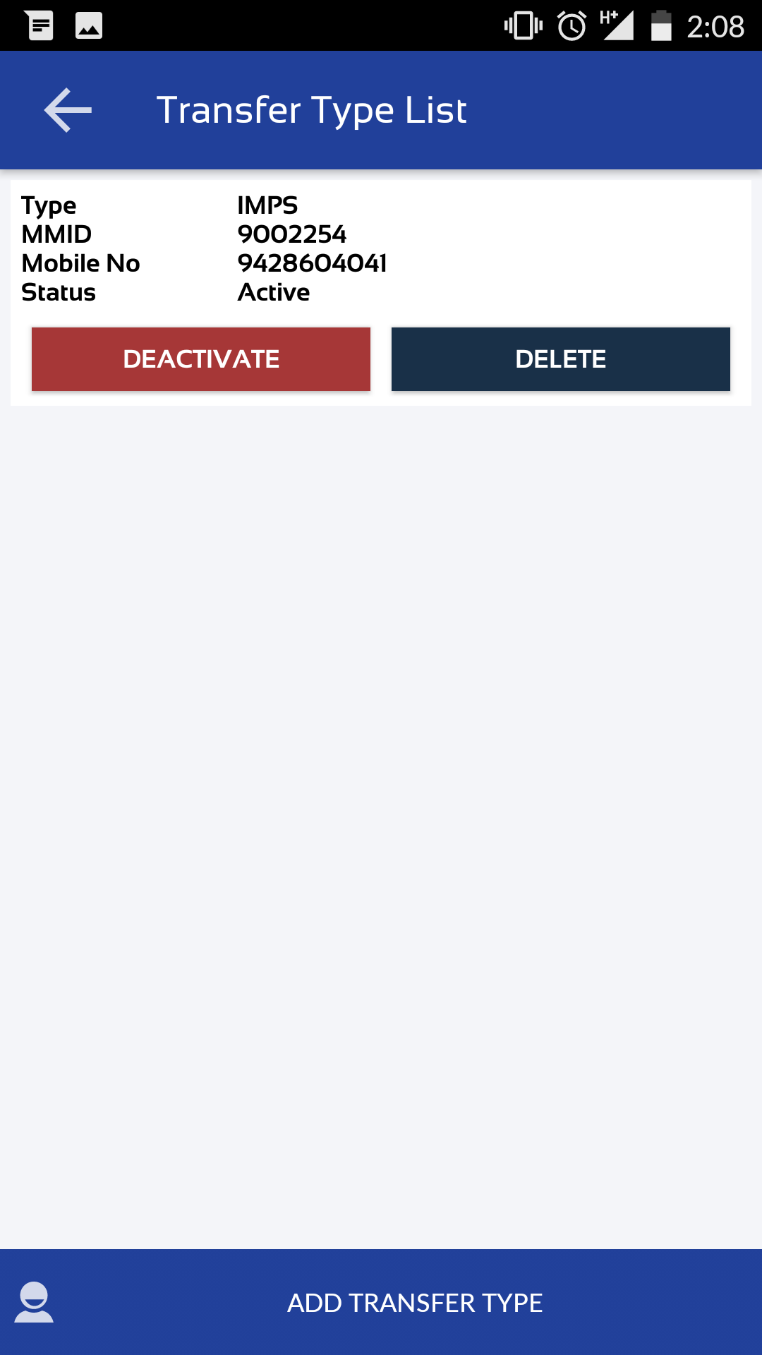
BENEFICIARY CONFIRMED - SETTING
After successfully activation application will show the beneficiary details.
Beneficiary can DEACTIVATE or DELETE even after activation confirmation.

Slide 36
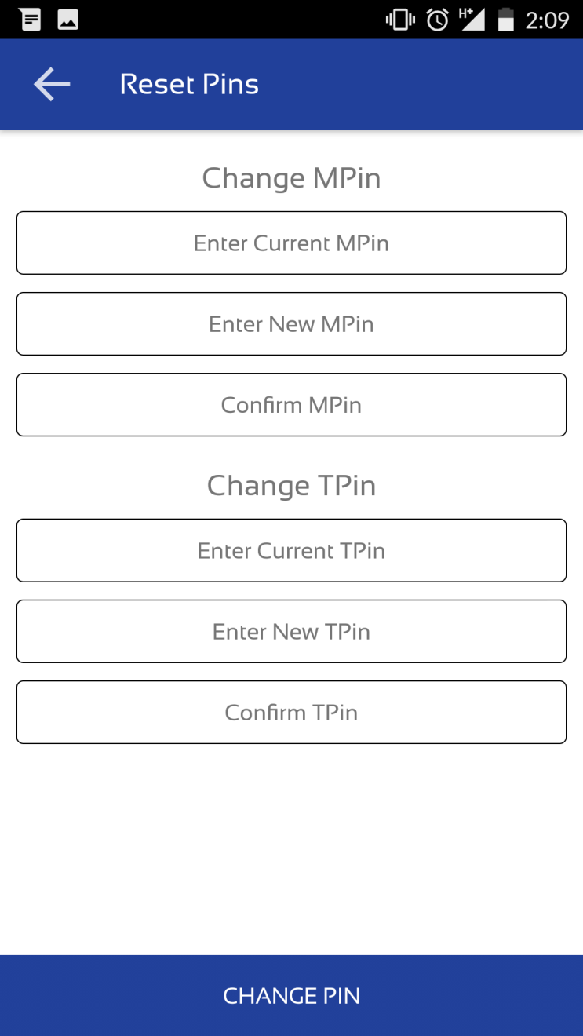
RESET PINS - SETTING
User can change MPIN or TPIN from Reset Pins.

Slide 37
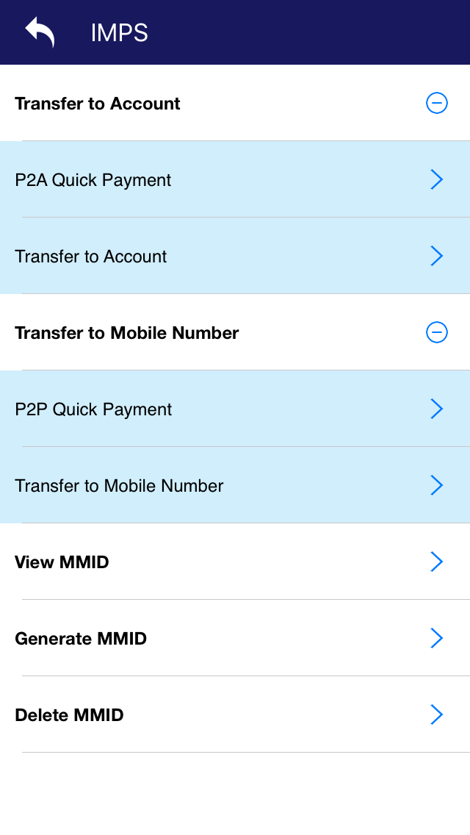
24 X 7 Transfer
24 X 7 Transfer have following options are available
Transfer to Account
Transfer to Mobile Number
View MMID
Generate MMID
Delete MMID

Slide 38
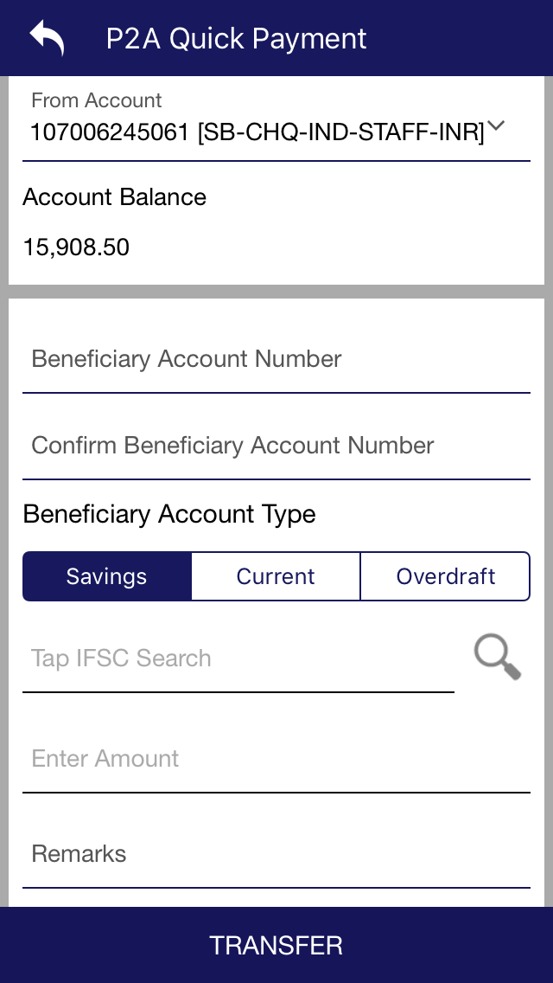
P2A Quick Payment – 24 X 7 Transfer
In P2A (Person To Account) Quick Payment user needs to enter beneficiary details as shown to Instant transfer to account.
Do not need to register beneficiary

Slide 39
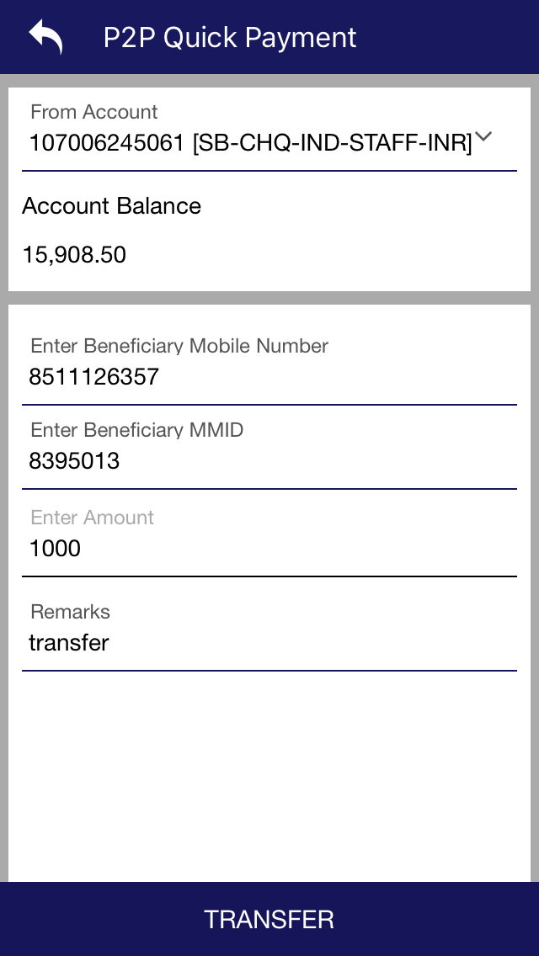
P2P Quick Payment – 24 X 7 Transfer
From P2P (Person to Person) Quick Payment user can transfer amount through Mobile number
And MMID.
For that he/she needs to have beneficiary registered mobile number and MMID.
Do not need to register beneficiary.

Slide 40
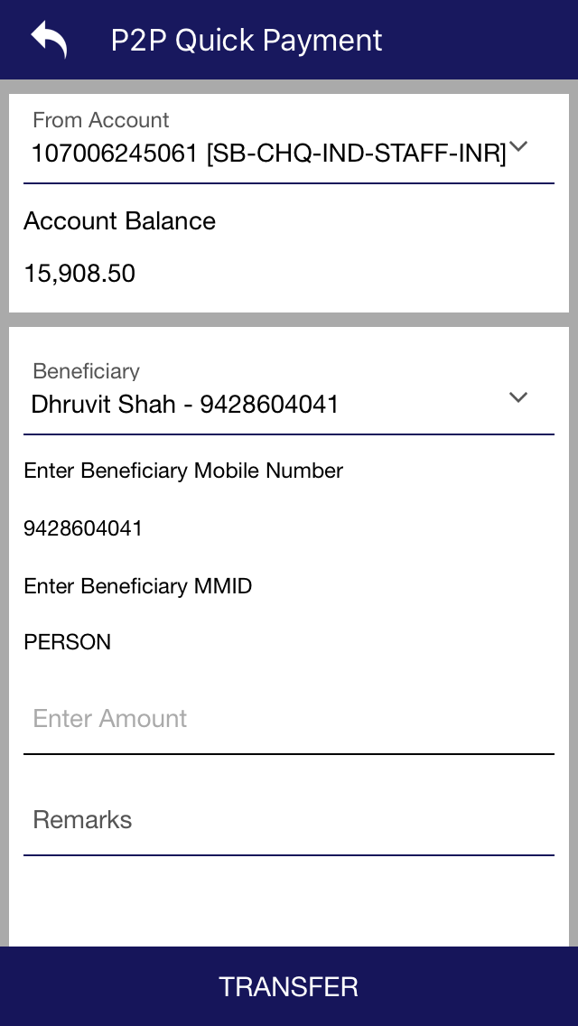
Transfer to Mobile – 24 X 7 Transfer
From Transfer to mobile user can transfer amount through Mobile number
and MMID.
For that he/she needs to have beneficiary registered mobile number and MMID.
Beneficiary needs to register.

Slide 41
Requests
From Scheduled Payment View/Delete user can view or delete the scheduled payment that he/she made for transfer.

Slide 42
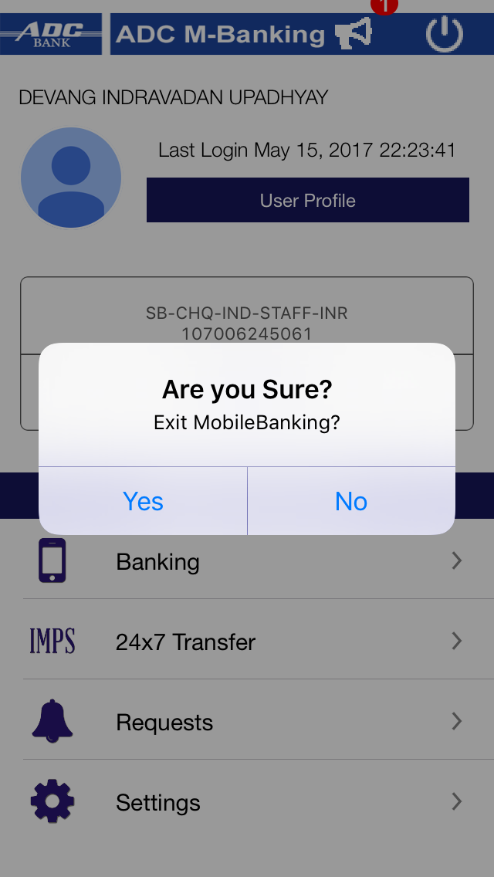
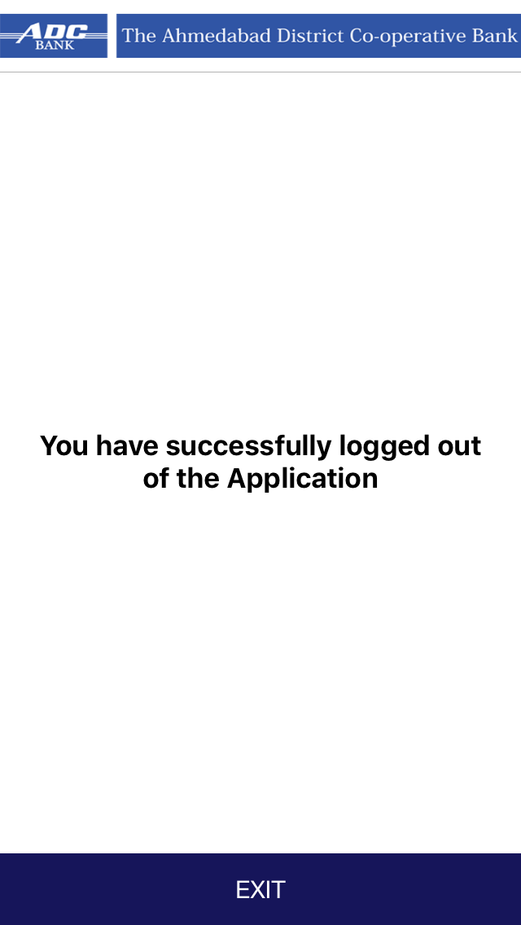
Log Out

Slide 43
Since 1925
www.adcbank.coop
Ib.mb@adcbank.coop

