Slide 1
E-Commerce --------------- Making online payment PAYTM Example
Since 1925

Slide 2
Making Online Payment
Since 1925

Slide 3
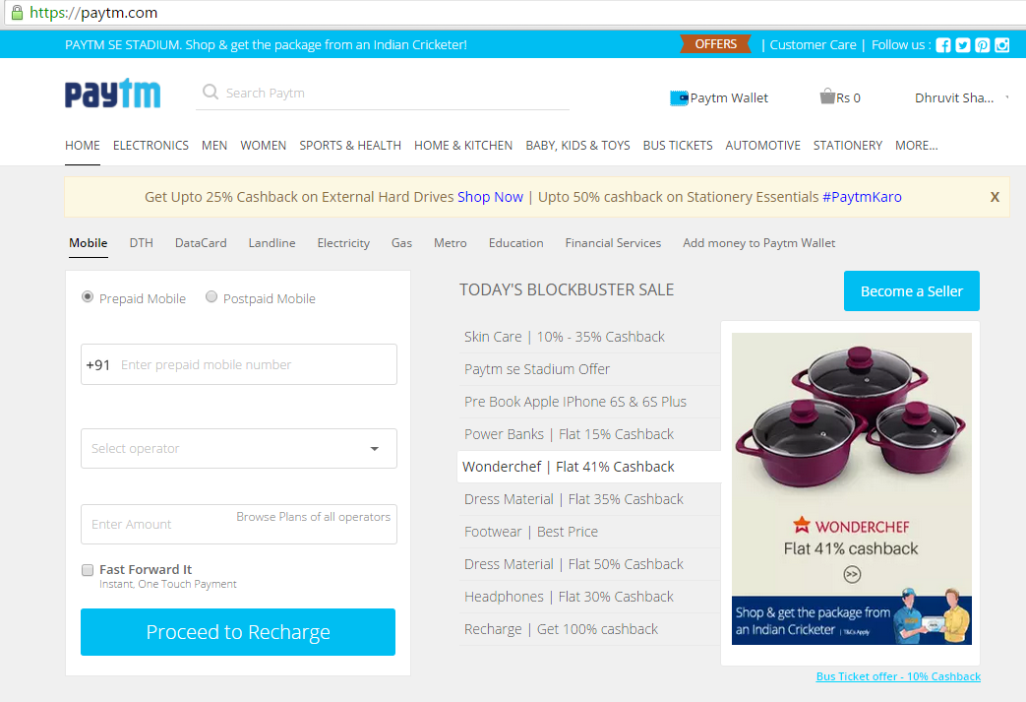
Step 1 – Open any E-Commerce website
Since 1925

Slide 4
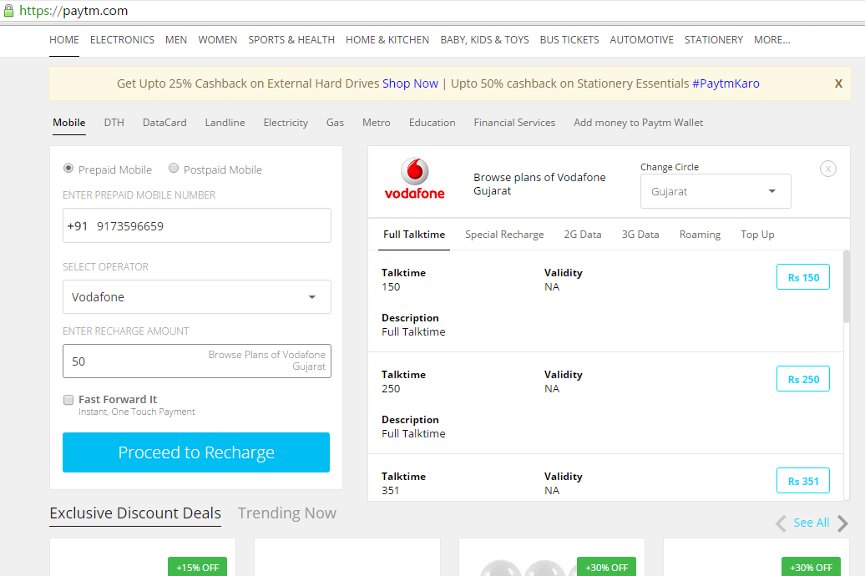
Step 2 – LOGIN to the website
In the bellow screen shot, we have taken example of PAYTM.COM.
Making a recharge
Since 1925

Slide 5
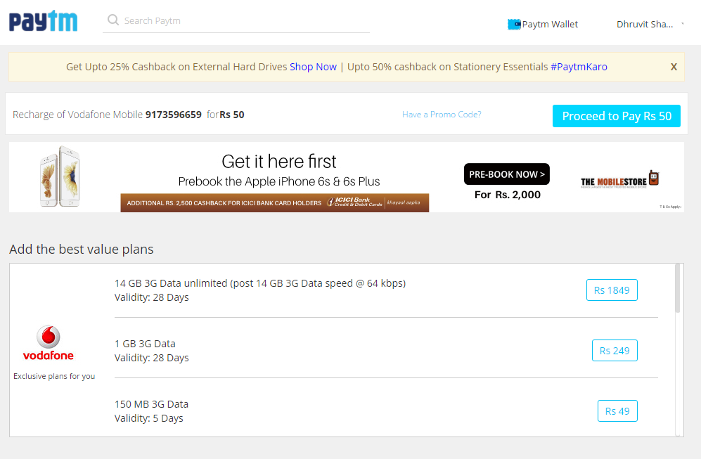
Step 3 – Click on PROCEED
Since 1925

Slide 6
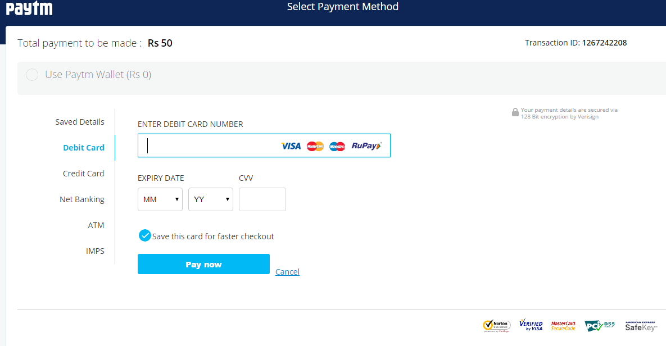
Step 4 – Click on DEBIT CARD
Since 1925

Slide 7
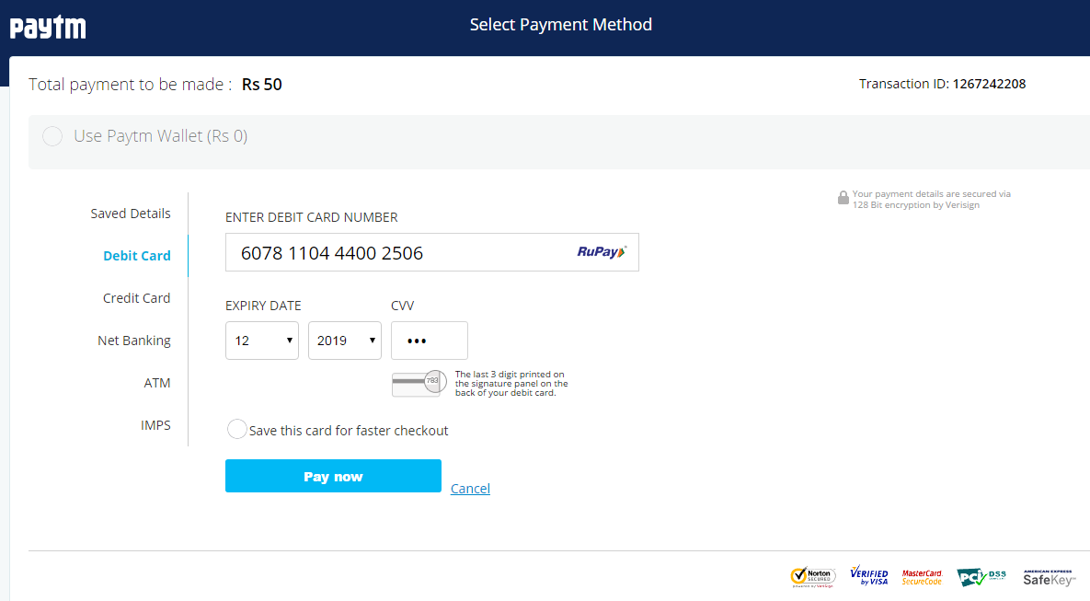
Step 5 – Enter the 16 digit card number, Expiry Month and Year
& CVV number (Click on PAY NOW)
Since 1925

Slide 8
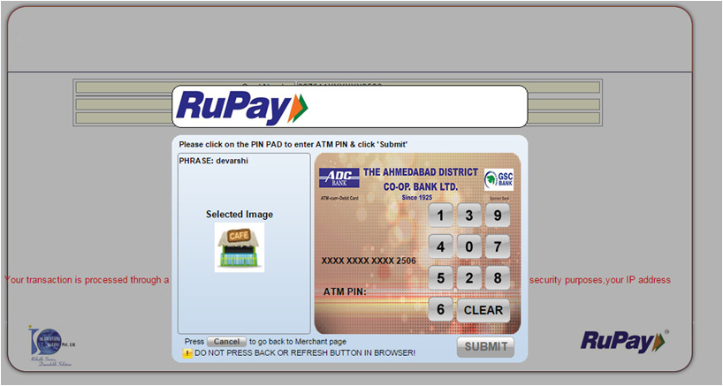
Step 6 – Select the image that you selected at the time of registration
Since 1925

Slide 9
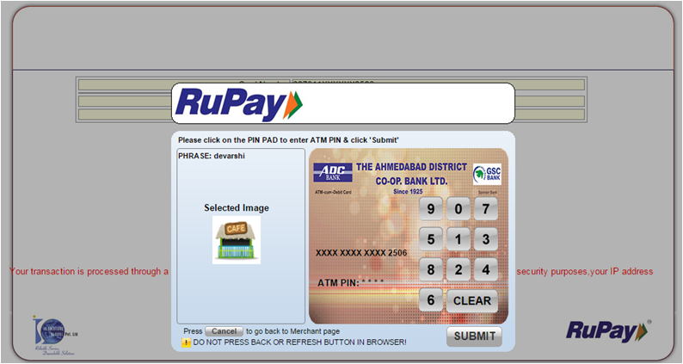
Step 7 – Enter 4 digit ATM PIN (Click on SUBMIT)
Since 1925

Slide 10
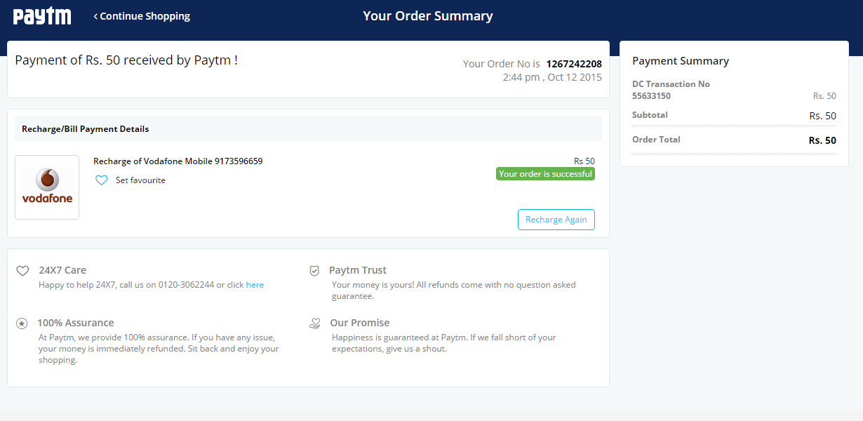
PAYMENT SUCCESSFUL
Since 1925

Slide 11
Since 1925
Since 1925
www.adcbank.coop
Ib.mb@adcbank.coop

